Slide 1
Advanced
Deep Learning

Slide 2
Recap

Slide 3
Logistic regression

Slide 4
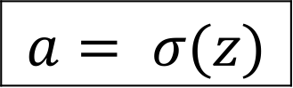
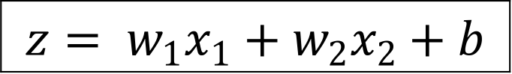
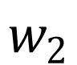
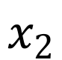
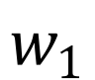
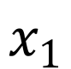
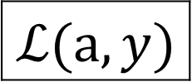
Logistic regression
$$x_{1}$$
$$w_{1}$$
$$x_{2}$$
$$z= w_{1}x_{1}+w_{2}x_{2}+b$$
$$a= σ(z)$$
$$ℒ(a,y)$$
$$w_{2}$$
b

Slide 5
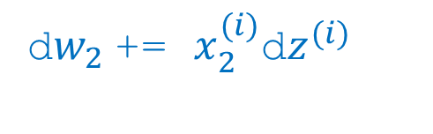
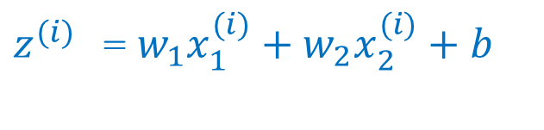
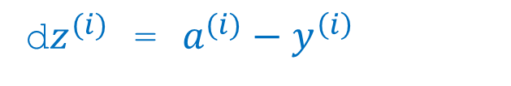
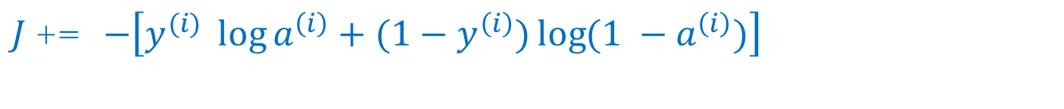
Logistic regression on m examples
J = 0, dw1 = 0, dw2 = 0, db = 0
for i = 1 to m:
$z^{(i)}$ =${ w}_{1}x_{1}^{(i)}+w_{2}x_{2}^{(i)}+b$
$a^{(i)}$ = $σ{(z}^{(i)})$
$J$+= $−\left[y^{(i)} \log{a^{\left(i\right)}+({1−y}^{\left(i\right)})\log{(1 −a^{\left(i\right)})}}\right]$
d$z^{(i)}$ = $a^{(i)}−y^{\left(i\right)}$
d${w_{1}}^{ }$+= $x_{1}^{(i)}\text{d}z^{(i)}$
d${w_{2}}^{ }$+= $x_{2}^{(i)}\text{d}z^{(i)}$
db += d$z^{(i)}$
J = J/m, d$w_{1}$ = d$w_{1}$/m, d$w_{2}$ = d$w_{2}$/m, db = db/m

Slide 6
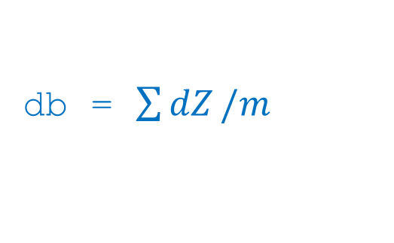
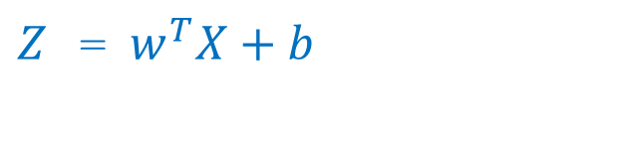
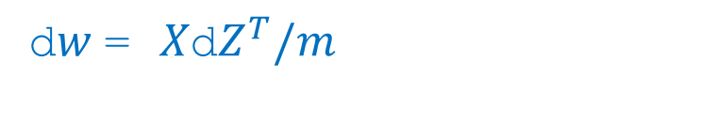
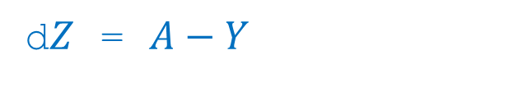
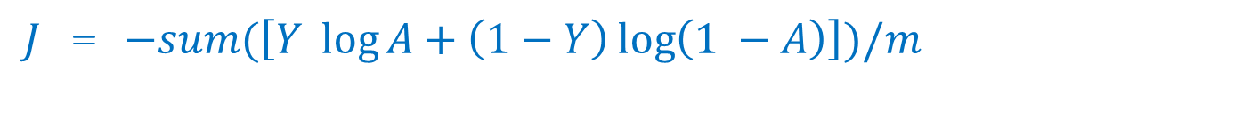
Logistic Regression Vectorization
$Z$ =$w^{T}X+b$
$A$ = $σ{(z}^{(i)})$
$J$= $−sum(\left[Y \log{A+\left(1−Y\right)\log\left(1 −A\right)}\right])/m$
d$Z$ = $A−Y$
d$w$= $X\text{d}Z^{T}/m$
db = $\sum{dZ}/m$

Slide 7
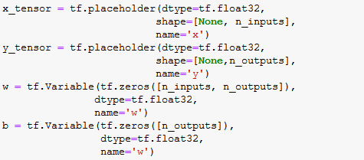
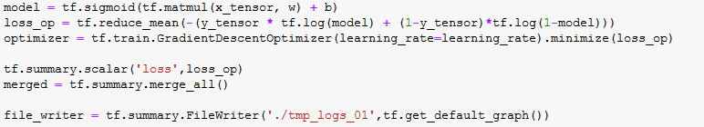
Tensorflow

Slide 8
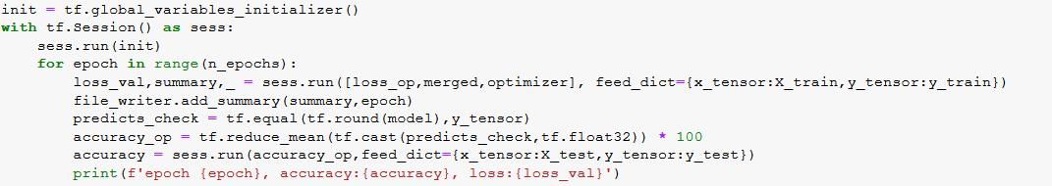
Tensorflow

Slide 9
Gradient Descent

Slide 10
Gradient Descent Variants
Batch or Deterministic
Stochastic or Online
Mini-batch Stochastic(stochastic)

Slide 11
Mini-batch sizes are generally driven by the following factors:
Larger batches provide a more accurate estimate of the gradient, but with less than linear returns.
Use some absolute minimum batch size, below which there is no reduction in the time to process a mini-batch.
If all examples in the batch are to be processed in parallel (as is typically the case), then the amount of memory scales with the batch size. For many hardware setups this is the limiting factor in batch size.
Some kinds of hardware achieve better runtime with specific sizes of arrays. Especially when using GPUs, it is common for power of 2 batch sizes to offer better runtime. Typical power of 2 batch sizes range from 32 to 256, with 16 sometimes being attempted for large models.
Small batches can offer a regularizing effect (Wilson and Martinez, 2003), perhaps due to the noise they add to the learning process.

Slide 12
Challenges
Vanilla mini-batch does not guarantee good convergence
Choosing a proper learning rate can be difficult
Learning rate schedules try to adjust the learning rate during training. These schedules have to be defined in advance.
The same learning rate applies to all parameter updates. It’s preferred to perform large update for rarely occurring features.
Saddle points and surrounding plateau of the same error

Slide 13
Gradient Descent Optimization Algorithms

Slide 14
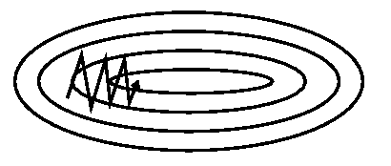
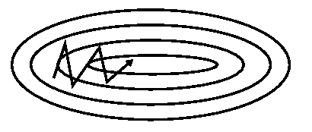
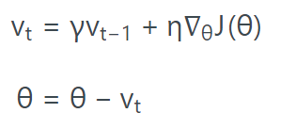
Momentum
SGD has trouble navigating ravines.
Without momentum
Without momentum
Formula:
Default parameters:
Gamma is set to 0.9

Slide 15
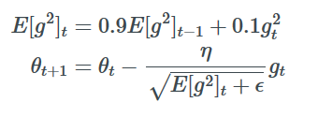
RMSProp
Frequently occurring features
Low learning rate
Infrequently occurring features
High learning rate
RMSprop is an unpublished, adaptive learning rate method proposed by Geoff Hinton
RMSProp and Adadelta both try to resolve the Adagrad's radically diminishing learning rates
Default parameters:
Like momentum set gamma to 0.9
Good default learning is 0.001

Slide 16
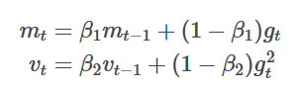
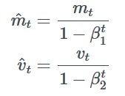
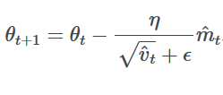
Adam Adaptive Momentum Estimation
Adam adds Momentum to RMSProp
Initial values of mt and vt are zero vectors and these values are biased to zero at initial steps…
Default parameters:
β1: 0.9
β2: 0.999
η: 0.001
ϵ: 1e-8

Slide 17

Visualization
optimization on loss surface contours

Slide 18

Visualization
optimization on saddle point

Slide 19

Visualization

Slide 20
Neural Network

Slide 21
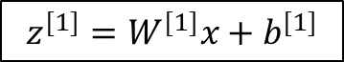
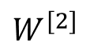
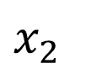
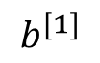
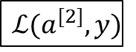
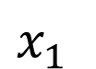
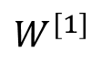
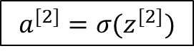
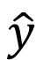
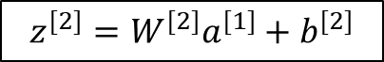
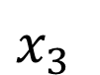
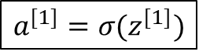
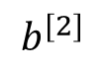
What is a Neural Network?
$$x_{1}$$
$$x_{2}$$
$$\hat{y}$$
$$x_{3}$$
x
$$W^{[1]}$$
$$z^{[1]}=W^{[1]}x+b^{[1]}$$
$$a^{[1]}=σ(z^{[1]})$$
$$z^{[2]}=W^{[2]}a_{ }^{[1]}+b^{[2]}$$
$$a^{[2]}=σ(z^{[2]})$$
$$ℒ(a^{[2]},y)$$
$$b^{[1]}$$
$$W^{[2]}$$
$$b^{[2]}$$

Slide 22
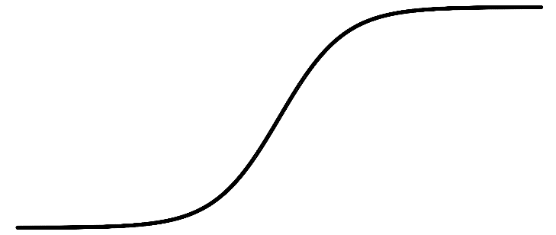
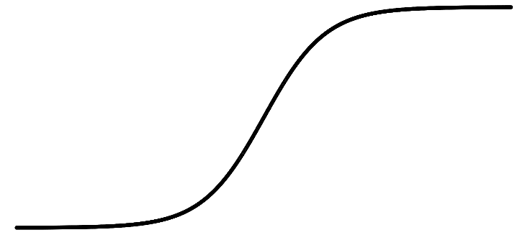
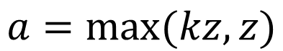
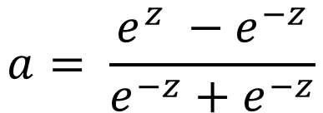
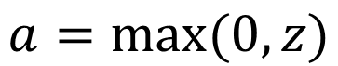
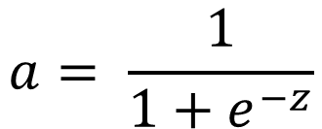
Pros and cons of activation functions
a
a
x
z
$$a= \frac{1}{1+e^{−z}}$$
sigmoid:
$$a= \frac{e^{z} −e^{−z}}{e^{−z}+e^{−z}}$$
tanh:
a
a
z
z
ReLU:
$$a=max⁡(0,z)$$
Leaky ReLU:
$$a=max⁡(kz,z)$$

Slide 23
Representation Learning
The representations are formed by composition of multiple non-linear transformations of the input data with the goal of yielding abstract and useful representations for tasks like classification, prediction etc

Slide 24
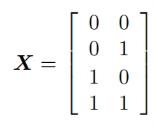
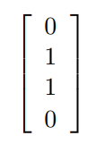
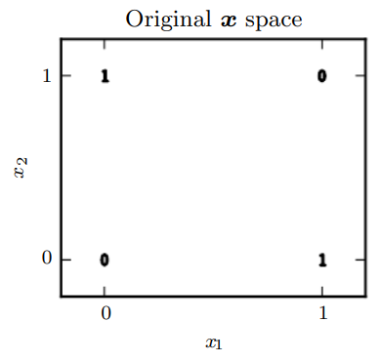
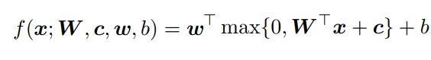
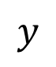





XOR Example
$$x_{1}$$
$$h1$$
$$y$$
$$Y=$$
$$x_{2}$$
$$h2$$

Slide 25







XOR Example
$$XW+c=$$
$$ReLU=\max\left(0, XW+c\right)=$$

Slide 26



XOR Example
b = 0
$$\max\left(0, XW+c\right)w+b=$$
Hidden layer :

Slide 27
Multi-Classification

Slide 28



Sigmoid
Soft-max

Slide 29


Loss Functions
Cross-Entropy loss
Binary Cross-Entropy loss

Slide 30
One-hot Encoding
A one hot encoding is a representation of categorical variables as binary vectors.
This first requires that the categorical values be mapped to integer values.
Then, each integer value is represented as a binary vector that is all zero values except the index of the integer, which is marked with a 1.

Slide 31

Example
data: ['red', 'red', 'green‘]
Representation:

Slide 32

Mnist Data-set

Slide 33

Keras

Slide 34
Regularization

Slide 35

What is regularization?

Slide 36


How does Regularization help reduce Over-fitting?

Slide 37


Different Regularization Techniques in Deep Learning
L2(Weight Decay):
L1:

Slide 38


Different Regularization Techniques in Deep Learning
Dropout (An Ensemble model)

Slide 39

Different Regularization Techniques in Deep Learning
Dropout (An Ensemble model)

Slide 40

Different Regularization Techniques in Deep Learning
Data Augmentation

Slide 41

Different Regularization Techniques in Deep Learning
Early Stopping

Slide 42
Metrics

Slide 43

Confusion Matrix
Confusion Matrix as the name suggests gives us a matrix as output and describes the complete performance of the model.
Binary classification

Slide 44
Confusion Matrix
There are 4 important terms:
True Positives : The cases in which we predicted YES and the actual output was also YES.
True Negatives : The cases in which we predicted NO and the actual output was NO.
False Positives : The cases in which we predicted YES and the actual output was NO.
False Negatives : The cases in which we predicted NO and the actual output was YES.

Slide 45

Confusion Matrix
Confusion Matrix forms the basis for the other types of metrics:
Accuracy
$$Accuracy=\frac{TruePositives+TrueNegatives}{Total number of samples}$$

Slide 46

True Positive Rate (Sensitivity)
TruePositiveRate$=\frac{TruePositives}{TruePositives + FalseNegatives}$
True Negative Rate (Specificity)
FalsePositiveRate$=\frac{TrueNegative}{TrueNegatives + FalsePositives}$

Slide 47
Precision
P$recision =\frac{TruePositives}{TruePositives +FalsePositive}$
Recall
R$ecall=\frac{TruePositives}{TruePositives + FalseNegatives}$

Slide 48


Precision v/s Recall

Slide 49

F1 Score
$$F1=2∗\frac{1}{ \frac{1}{precision}+\frac{1}{recall}}$$
F1 Score is the Harmonic Mean between precision and recall
F1 Score tries to find the balance between precision and recall.
F1 does not miss a significant number of instances

Slide 50


Mean Absolute Error
$$MeanAbsoluteError=\frac{1}{N}\sum_{j=1}^{N}{|y_{j}−{\hat{y}}_{j}}|$$
Mean Squared Error
$$MeanSquaredError=\frac{1}{N}\sum_{j=1}^{N}{(y_{j}−{\hat{y}}_{j}})^{2}$$

Slide 51
Imbalance dataset

Slide 52
How to tackle Imbalance datasets
Collect more data
Change your performance Metric
Generate Synthetic Samples

Slide 53
How to tackle Imbalance datasets
Resample your dataset
Over-sampling
Under-sampling

Slide 54
How to tackle Imbalance datasets
Try Penalized Models
You cannot change algorithm
You cannot change dataset
Resampling has no effect

Slide 55
Hyper-Parameter Tuning

Slide 56
Datasets
Train
Training parameters
Validation
Training hyper-parameters
Test
Testing model

Slide 57
Automatic-hyper parameter tuning
Evolutionary Algorithms
Reinforcement Learning
Gaussian Processing

Slide 58
Setting Up a Baseline
Random Forest
Other methods

Slide 59

Grid Search & Random Search

